Slide 1
Causal machine learning in practice
Amit Sharma
Principal Researcher
Microsoft Research
www.amitsharma.in Twitter: @amt_shrma

Slide 2
Two session series on Causal ML
Session 1: Intro to causal machine learning
Estimating causal effect, explaining outcomes, and out-of-distribution generalization
Session 2: Causal machine learning in practice
PyWhy/DoWhy and the promise of large language models

Slide 3
Session goals: Causal ML in practice
Understand key challenges of applying causal ML in the real world
Learn about open-source tools for building causal models
See causal ML in action through three real-world case studies
Customer rewards program in e-commerce platform
Debugging high latency in a microservice system architecture
Classifying images under spurious correlation
Looking ahead: Explore how large language models may help with some of these challenges
How can LLMs help infer the correct causal graph?

Slide 4
Outline
The four key steps of causal inference
PyWhy software ecosystem for causal ML
Open-source libraries: DoWhy, EconML, causal-learn, and more…
Case-studies of applying causal ML using PyWhy/DoWhy
Effect estimation
Root cause attribution
Out-of-distribution prediction
Looking ahead: Promise of large language models for causality

Slide 5
Section 1: The 4 Key Steps of Causal Inference

Slide 6

Two Fundamental Challenges for Causal Inference
Multiple causal mechanisms and estimates can fit the same data distribution.
1. Assumptions
Estimation about different data distributions than the training distribution (no easy “cross-validation”).
2. Evaluation
Real World: do(A=1)
Counterfactual World: do(A=0)

Slide 7
The four key steps of causal inference to highlight the importance of assumptions
Modeling assumptions: Create a causal graph to encode assumptions.
Identification: Formulate what to estimate.
E.g., use backdoor criterion.
Estimation: Compute the estimate.
E.g., use matching or debiased ML.
Refuting assumptions: Validate the assumptions.

Slide 8
To implement these 4 steps, we built DoWhy, an open-source library for causal inference
DoWhy makes assumptions front-and-center of any analysis
Transparent declaration of assumptions
Evaluation of those assumptions, to the extent possible
Most popular causal library on GitHub (> 2M downloads, 800+ forks)
Taught in third-party tutorials and courses: O’Reilly, PyData, Northeastern, …
Open-source community: 60 contributors
Including major contributions: Pandas dataframe extension
Goal: An end-to-end platform for doing causal inference

Slide 9
DoWhy provides a general API for the four steps of causal inference
Modeling: Create a causal graph to encode assumptions.
Identification: Formulate what to estimate.
Estimation: Compute the estimate.
Refutation: Validate the assumptions.
We’ll discuss the four steps and show a code example using DoWhy.

Slide 10
v1,v2
PyWhy
Input Data
<action, outcome, other variables>
w
Action
Outcome
v3
v5
Causal-learn
DoWhy
EconML
DoWhy
Model causal mechanism
Identify the target estimand
Estimate causal effect
Estimate causal effect
Refute estimate
Construct a causal graph based on domain knowledge
Formulate correct estimand based on the causal model
Use a suitable method to estimate effect
Check robustness of estimate to assumption violations
Domain Knowledge
Causal effect
Notes:
What DoWhy does is that it implements the hard parts of all three steps, leading to an easy interface. The user still has to provide domain knowledge, that’s a harder problem we don’t solve yet..but we want to..

Slide 11
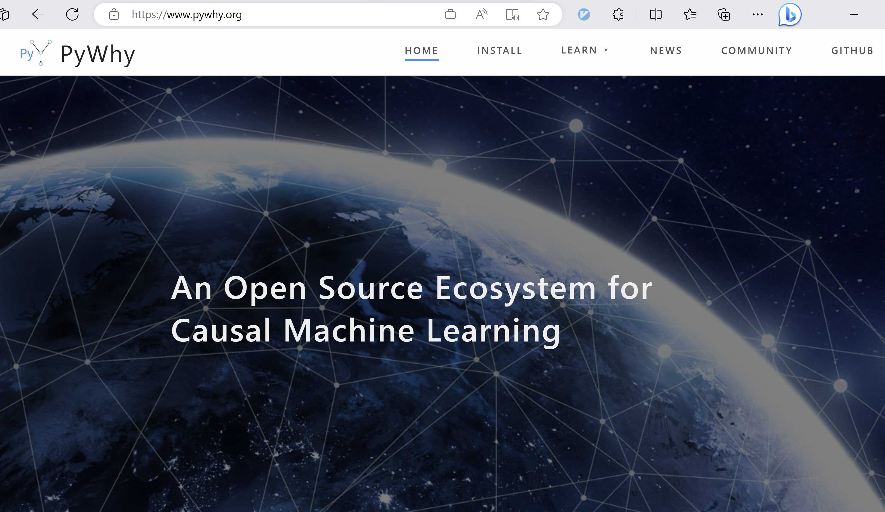

Slide 12
Section 2: Case studies using DoWhy/PyWhy

Slide 13
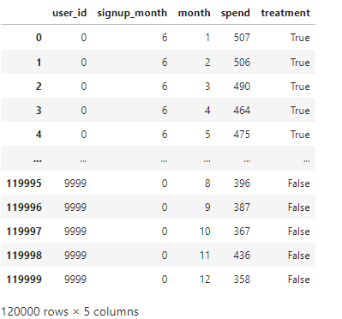
Case Study 1: Estimating the effect of a customer loyalty rewards program
What is the impact of offering the customer loyalty program on total sales?
If the current members had not signed up for the program, how much less would they have spent?
ATT: Average treatment effect on the treated (customers who signed up for the program)
You can try out this example on Github: github.com/microsoft/dowhy/blob/master/docs/source/example_notebooks/dowhy_example_effect_of_memberrewards_program.ipynb

Slide 14
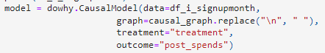
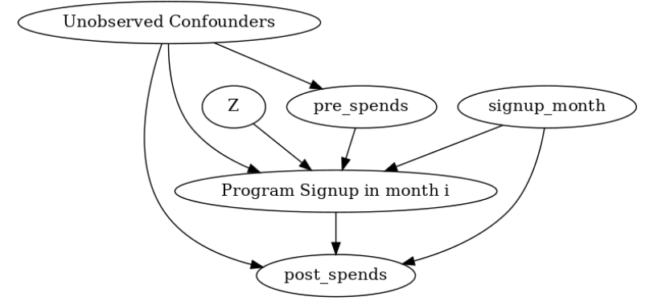
Step 1: Modeling. Create causal graph to encode assumptions.
Notes:
Modeling: Create a causal graph to encode assumptions.
Identification: Formulate what to estimate.
Estimation: Compute the estimate.
Refutation: Validate the assumptions.

Slide 15
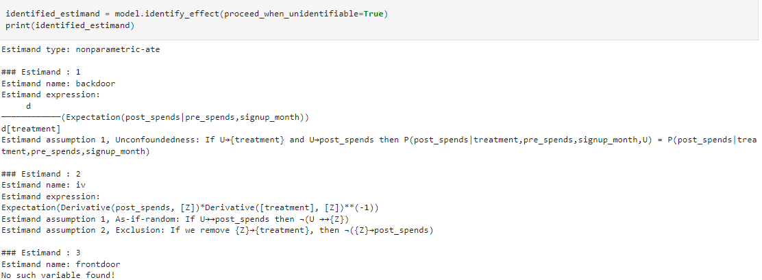
Step 2: Identification. Formulate what to estimate

Slide 16
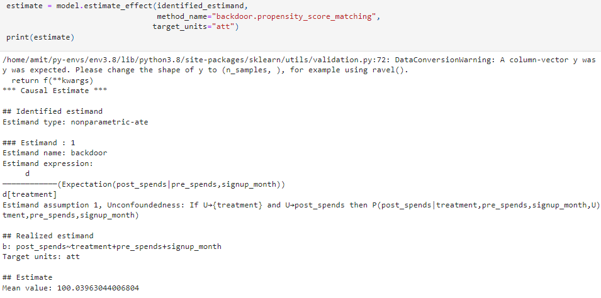
Step 3: Estimation. Compute the estimate

Slide 17
Step 4: Refutation. Validate the assumptions
Obtained estimate depends on many (untestable) assumptions.
Model:
Did we miss any unobserved variables in the assumed graph?
Did we miss any edge between two variables in the assumed graph?
Identify:
Did we make any parametric assumption for deriving the estimand?
Estimate:
Is the assumed functional form sufficient for capturing the variation in data?
Do the estimator assumptions lead to high variance?

Slide 18
Best practice: Do refutation/robustness tests for as many assumptions as possible
UNIT TESTS
INTEGRATION TESTS
Model:
Conditional Independence Test
Identify:
D-separation Test
Estimate:
Bootstrap Refuter
Data Subset Refuter
Test all steps at once.
Placebo Treatment Refuter
Dummy Outcome Refuter
Random Common Cause Refuter
Sensitivity Analysis
Simulated Outcome Refuter /Synth-validation [Schuler et al. 2017]
All these refutation methods are implemented in DoWhy. Caveat: They can refute a given analysis, but cannot prove its correctness.

Slide 19
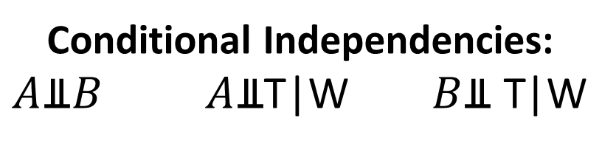
Example 1: Conditional Independence Refuter
Through its edges, each causal graph implies certain conditional independence constraints on its nodes. [d-separation, Pearl 2009]
Model refutation: Check if the observed data satisfies the assumed model’s independence constraints.
Use an appropriate statistical test for independence [Heinze-Demel et al. 2018].
If not, the model is incorrect.
A
B
W
T
Y
Conditional Independencies: $A\text{⫫}B A\text{⫫}$T|W $B\text{⫫} \text{T}$|W

Slide 20
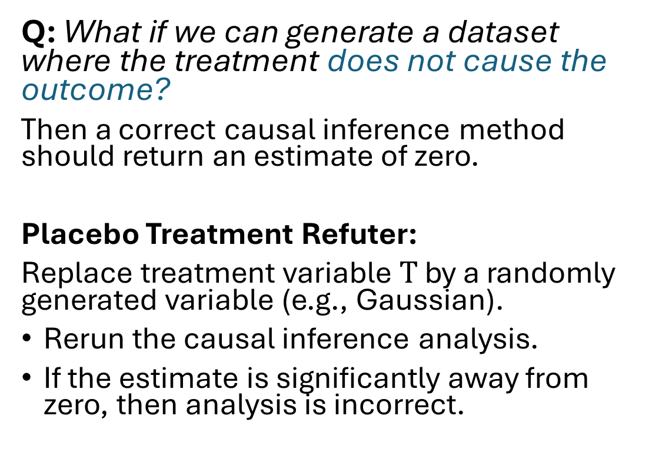
Example 2: Placebo Treatment (“A/A”) Refuter
W
Q: What if we can generate a dataset where the treatment does not cause the outcome?
Then a correct causal inference method should return an estimate of zero.
Placebo Treatment Refuter:
Replace treatment variable $T$ by a randomly generated variable (e.g., Gaussian).
Rerun the causal inference analysis.
If the estimate is significantly away from zero, then analysis is incorrect.
Original Treatment
T
Y
W
“Placebo” Treatment
?
T
Y

Slide 21
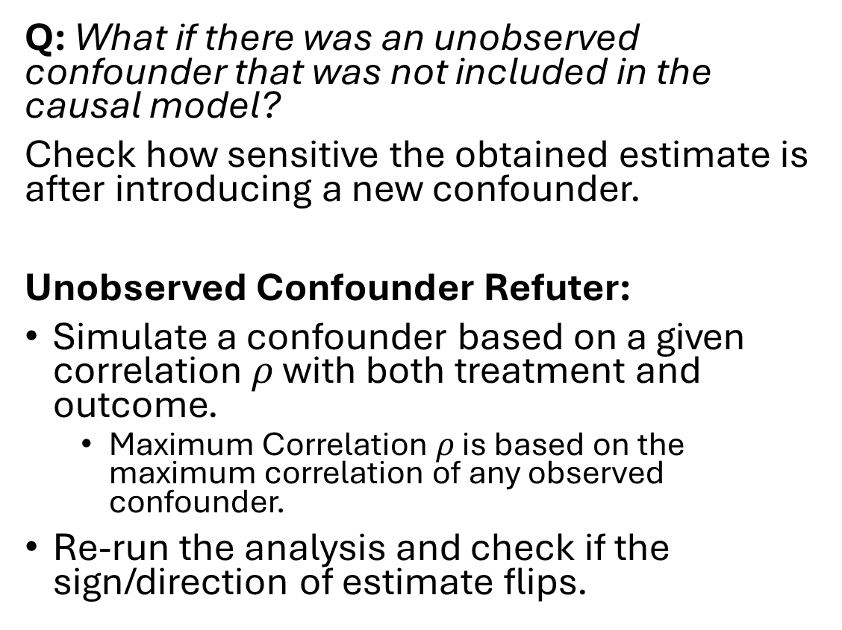
Example 3: Add Unobserved Confounder to check sensitivity of an estimate
W
Observed Confounders
Q: What if there was an unobserved confounder that was not included in the causal model?
Check how sensitive the obtained estimate is after introducing a new confounder.
Unobserved Confounder Refuter:
Simulate a confounder based on a given correlation $ρ$ with both treatment and outcome.
Maximum Correlation $ρ$ is based on the maximum correlation of any observed confounder.
Re-run the analysis and check if the sign/direction of estimate flips.
T
Y
W
U
Unobserved Confounder
T
Y

Slide 22
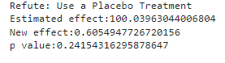
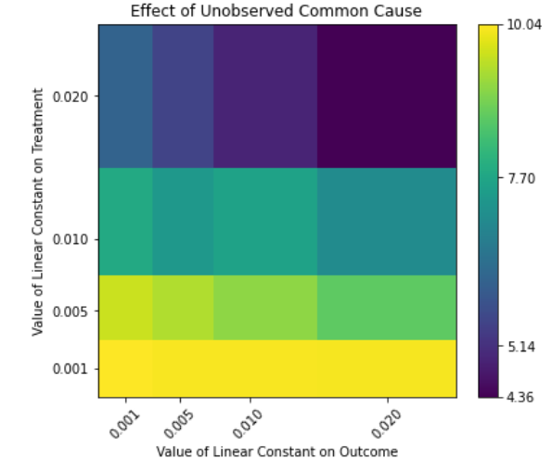
Step 4: Refutation. Validate the assumptions

Slide 23
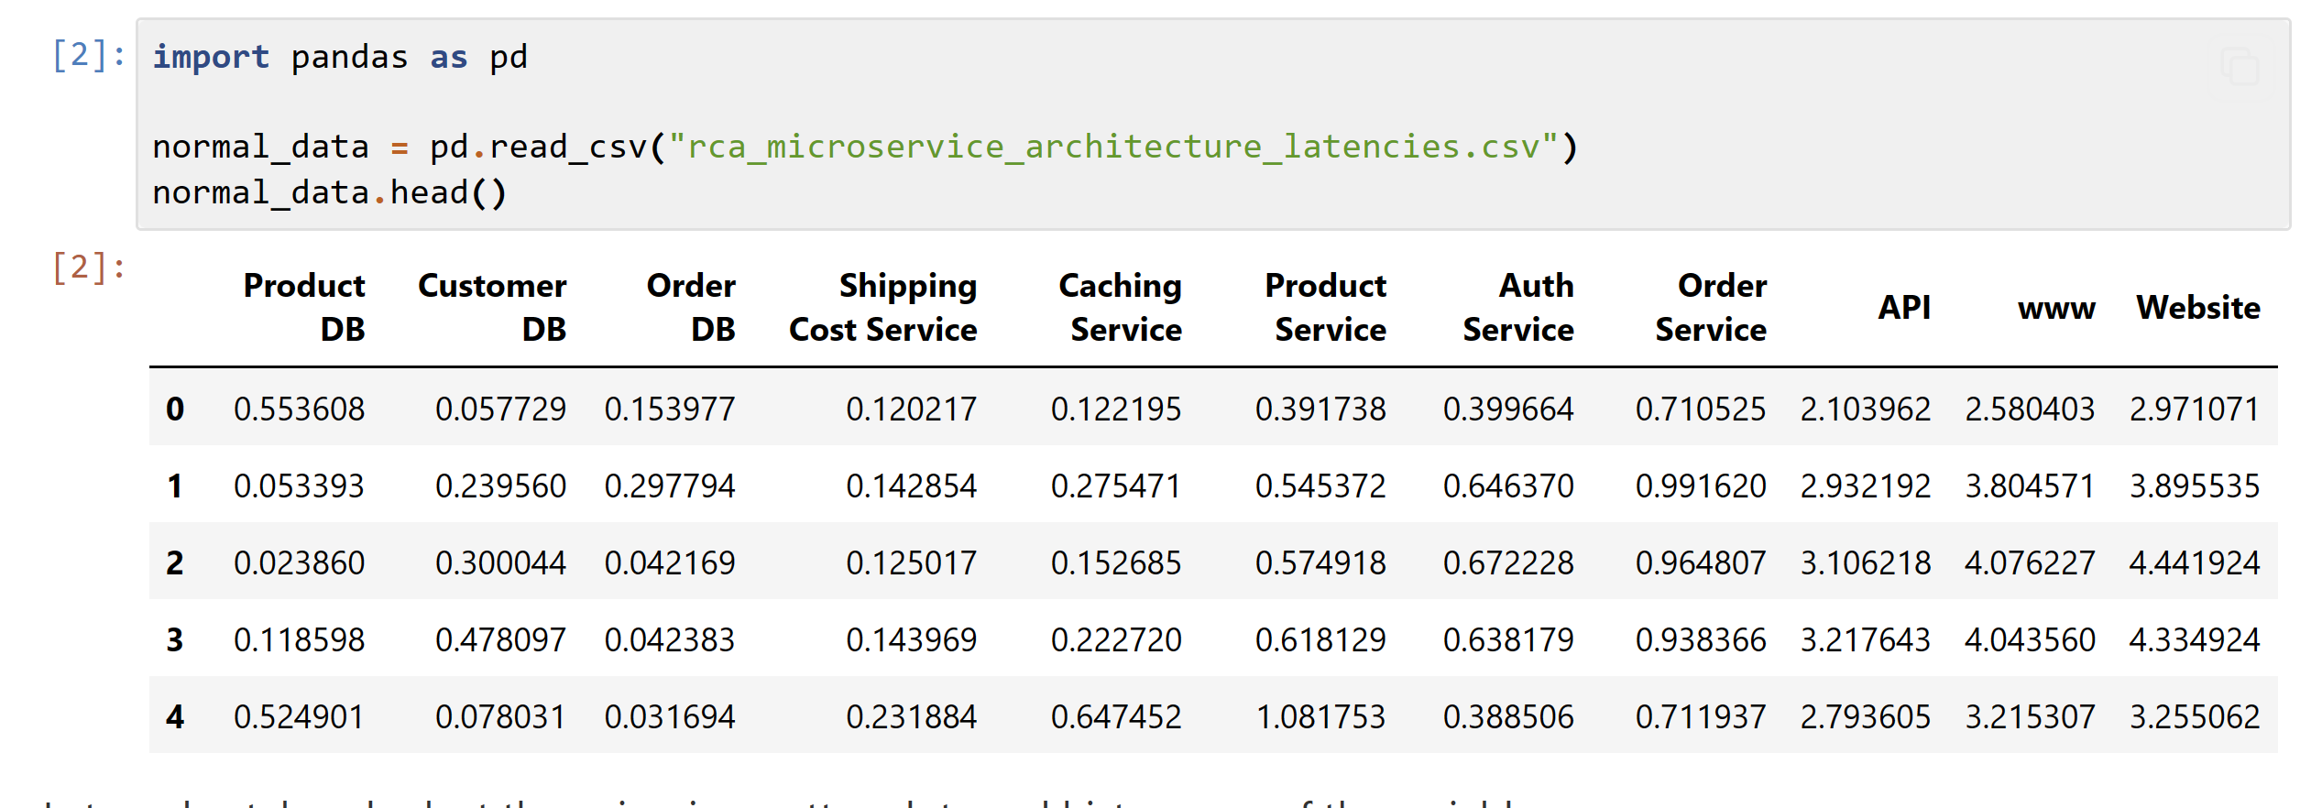
Case study 2: Finding the root cause of elevated latency in a microservice architecture

Slide 24
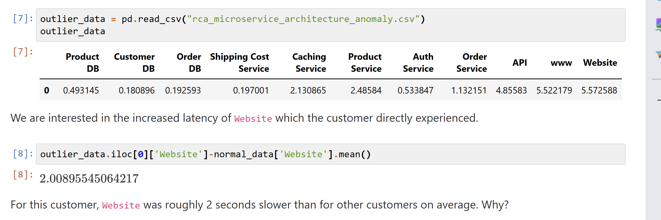
Why does the latency of website increase by 2 seconds?

Slide 25
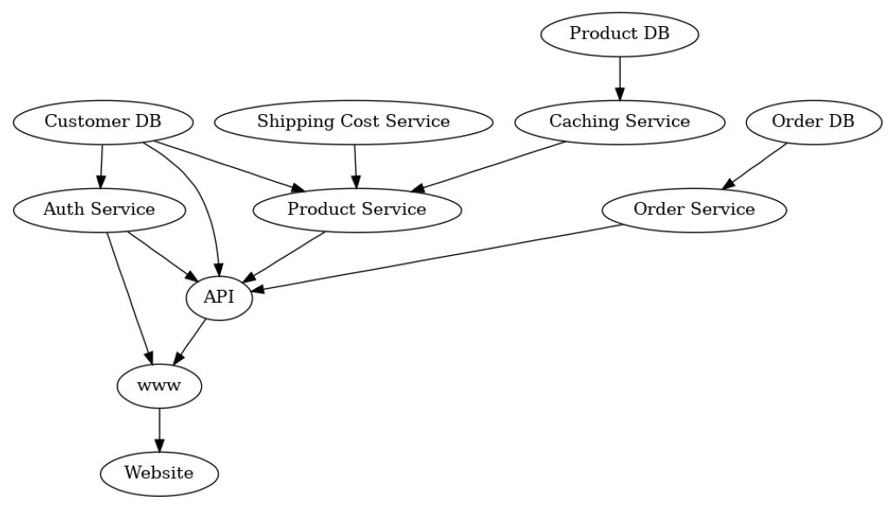
Step 1: Building the causal graph

Slide 26
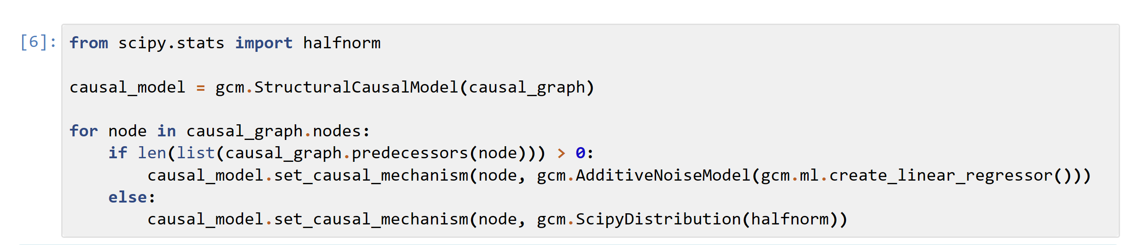
Step 2: Identifying the estimate
In this case, we require a counterfactual estimate.
So, we assume all variables are observed, and fit an SCM.

Slide 27
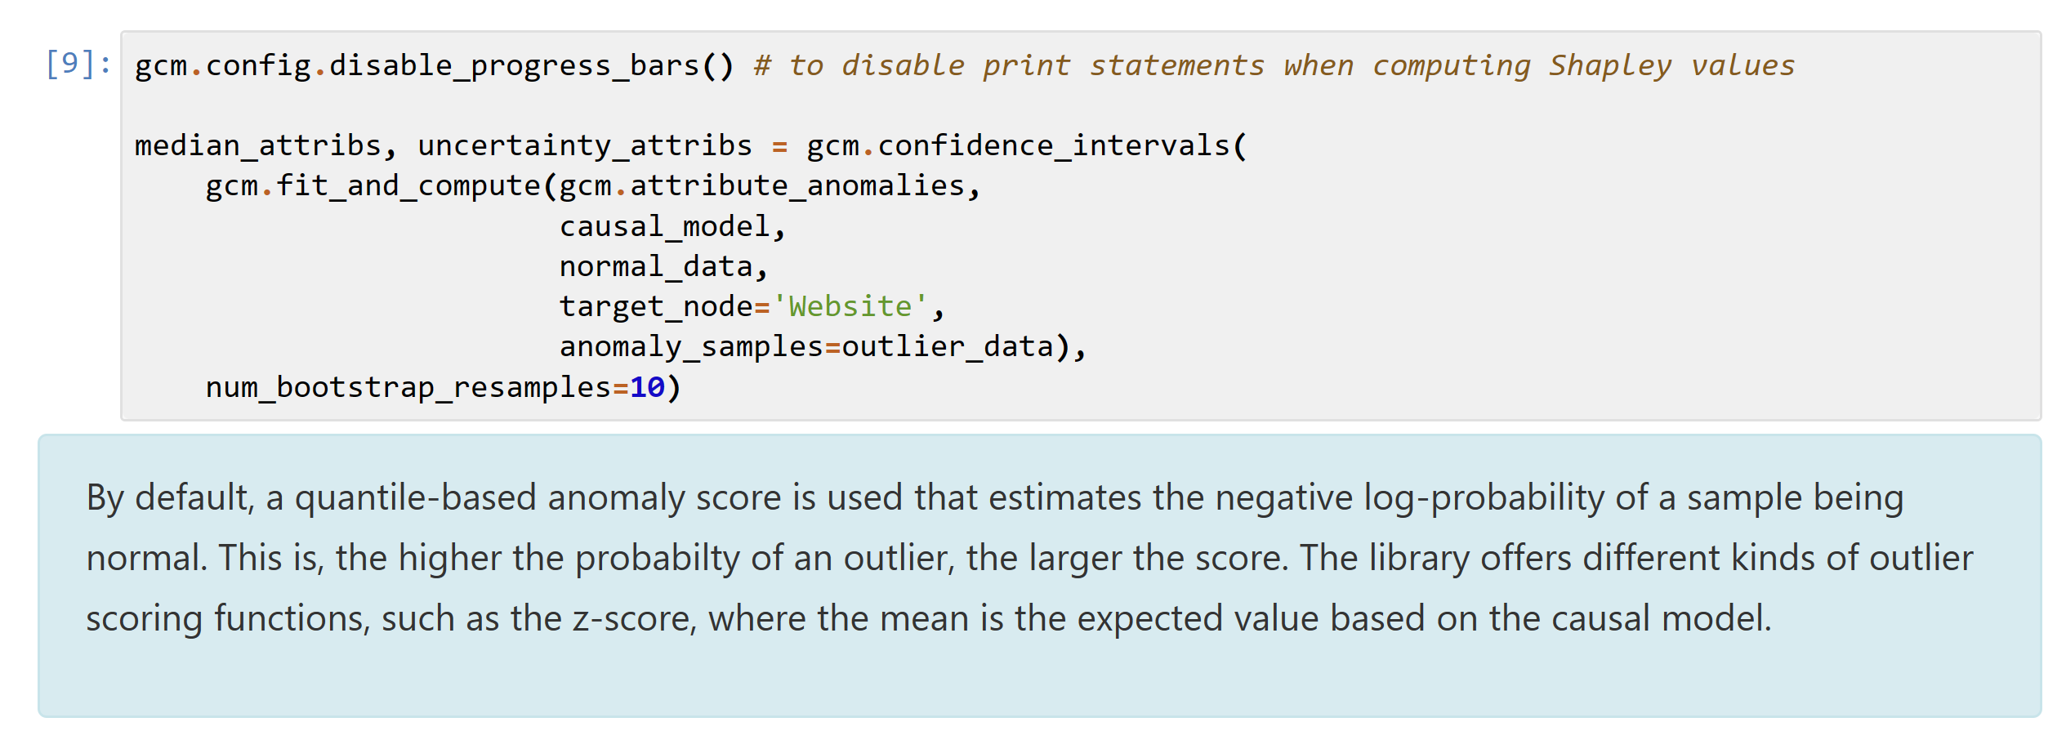
Step 3: Estimating the counterfactual + attribution

Slide 28
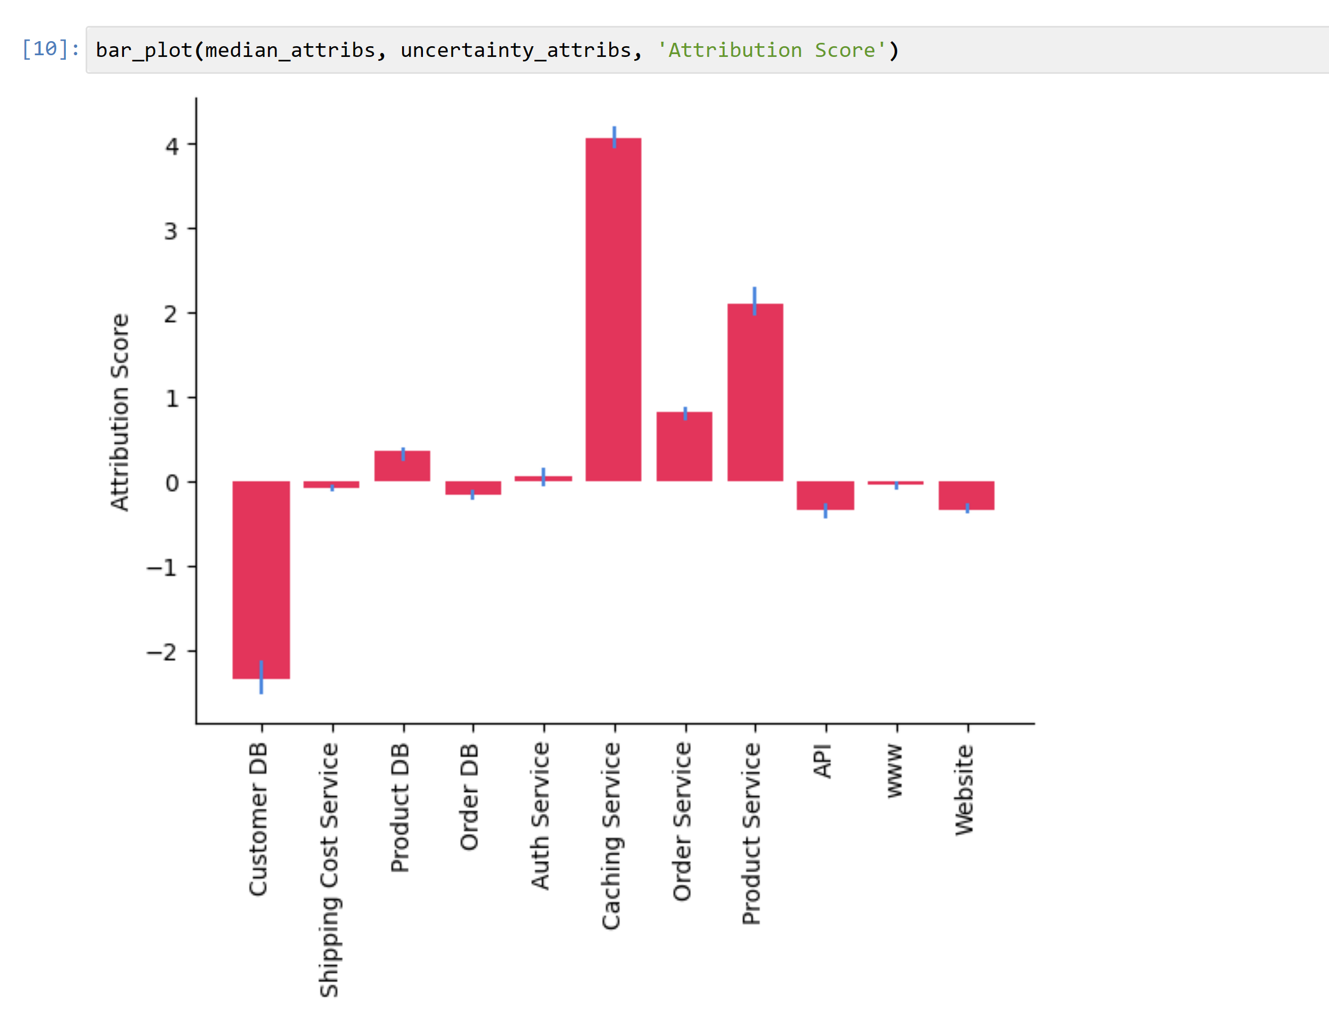

Slide 29
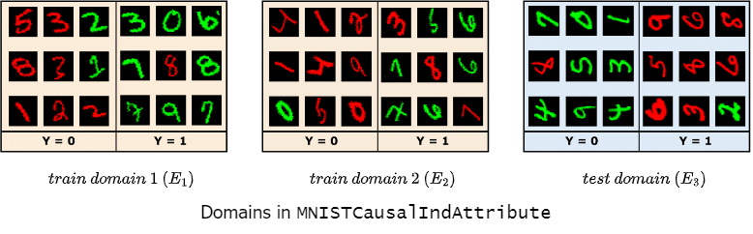
Case study 3: Classifying images under spurious correlation
Task: detect the digit in each image.

Slide 30
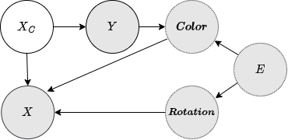
Step 1: Model the causal graph

Slide 31
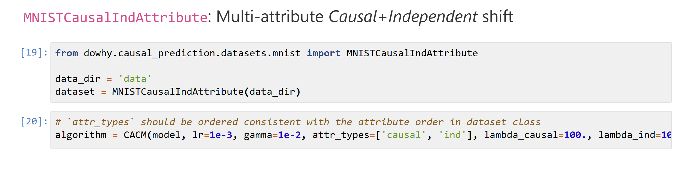
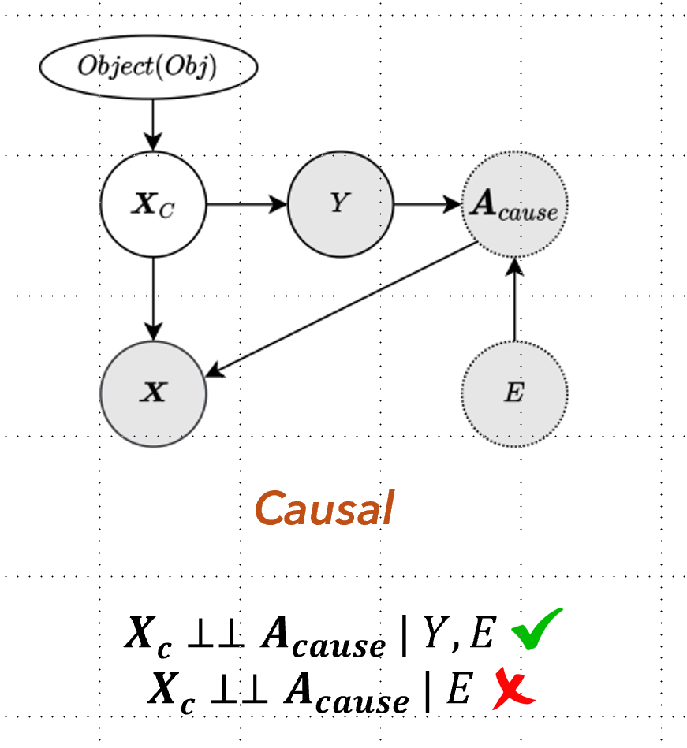
Step 2: Identify the causal predictor

Slide 32
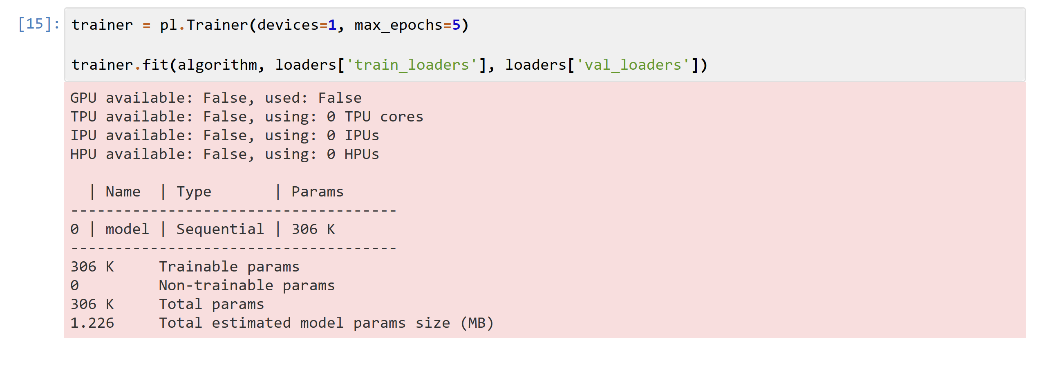
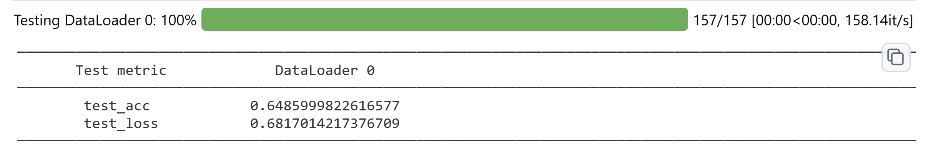
Step 3: Fit the causal predictor

Slide 33
Section 3: The promise of large language models (LLMs) for causality
To what extent can we learn the causal graph?

Slide 34
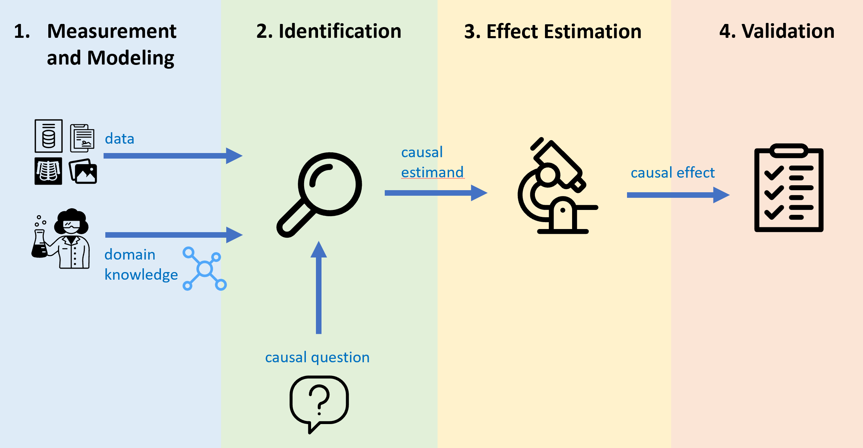
Domain knowledge is critical to correct causal analysis
Sobering results using SoTA graph discovery algorithms on real-world data, due to the difficulty of learning causal relationships from data alone, [Tu et al. 2019, Huang et al. 2021, Kaiser & Sipos 2022]

Slide 35
Causal discovery: Two common tasks
Pairwise discovery
Full graph discovery
Given a pair of variables (A,B), decide whether A causes B or B causes A?
Given a set of variables infer a directed acyclic graph over them.
Infer which pairs of variables form an edge, and their direction.
A
B
B
A
B
A
C
D

Slide 36
Pairwise discovery
A
B
A
B
Observed distribution: P(A,B)
Graph 1 factorization: P(B|A) P(A)
Graph 2 factorization: P(A|B) P(B)
Both have the same likelihood given observed data.
Impossible to determine direction non-parametrically.
Recent work: assumes non-linear models or non-gaussian noise (e.g. LinGAM)

Slide 37
Full graph discovery
B
A
C
D
Chain Fork Collider
B indep C|A B indep C|A B indep C
For some edges, can determine the direction whenever there is a collider (PC algorithm)
Recent work: Formulates it as a continuous optimization problem and simply learns a graph with acyclic constraint (e.g., NOTEARS)
B
B
B
A
A
A
C
C
C

Slide 38
Now let’s look at how LLMs may help

Slide 39
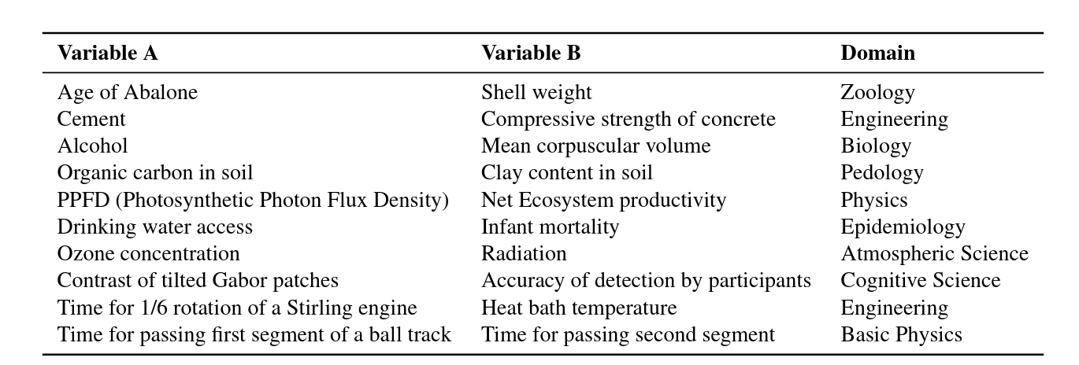
Pairwise discovery: Tübingen Benchmark
104 variable pairs spanning range of fields [Mooij et al. 2016]
Challenging task: Most existing algorithms achieve 70-80% accuracy, Best is 83% [Mosaic, Wu & Fukumizu 2020].

Slide 40
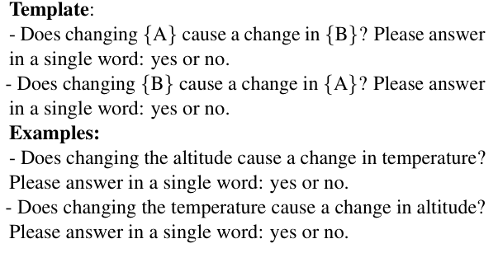
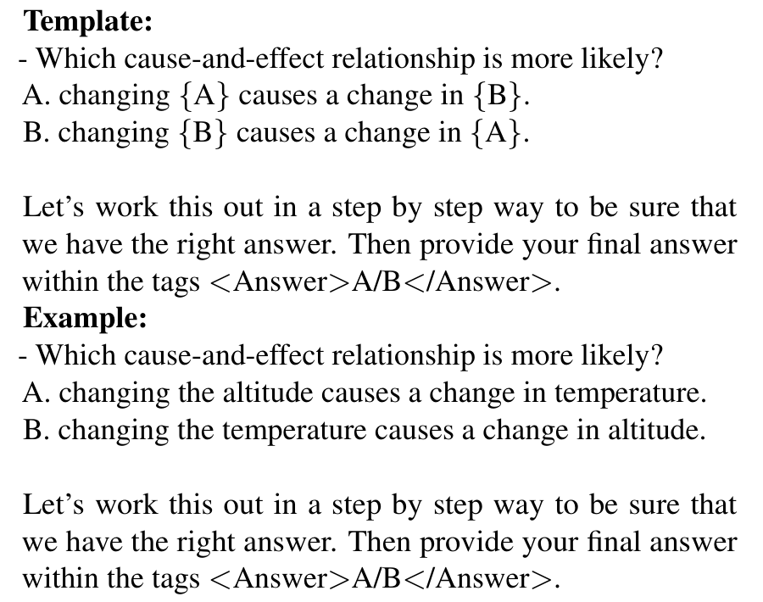
Applying LLMs to pairwise causal discovery
Method: For each pair, input below prompts to an LLM and record the output.
Two prompts per pair
Single prompt

Slide 41
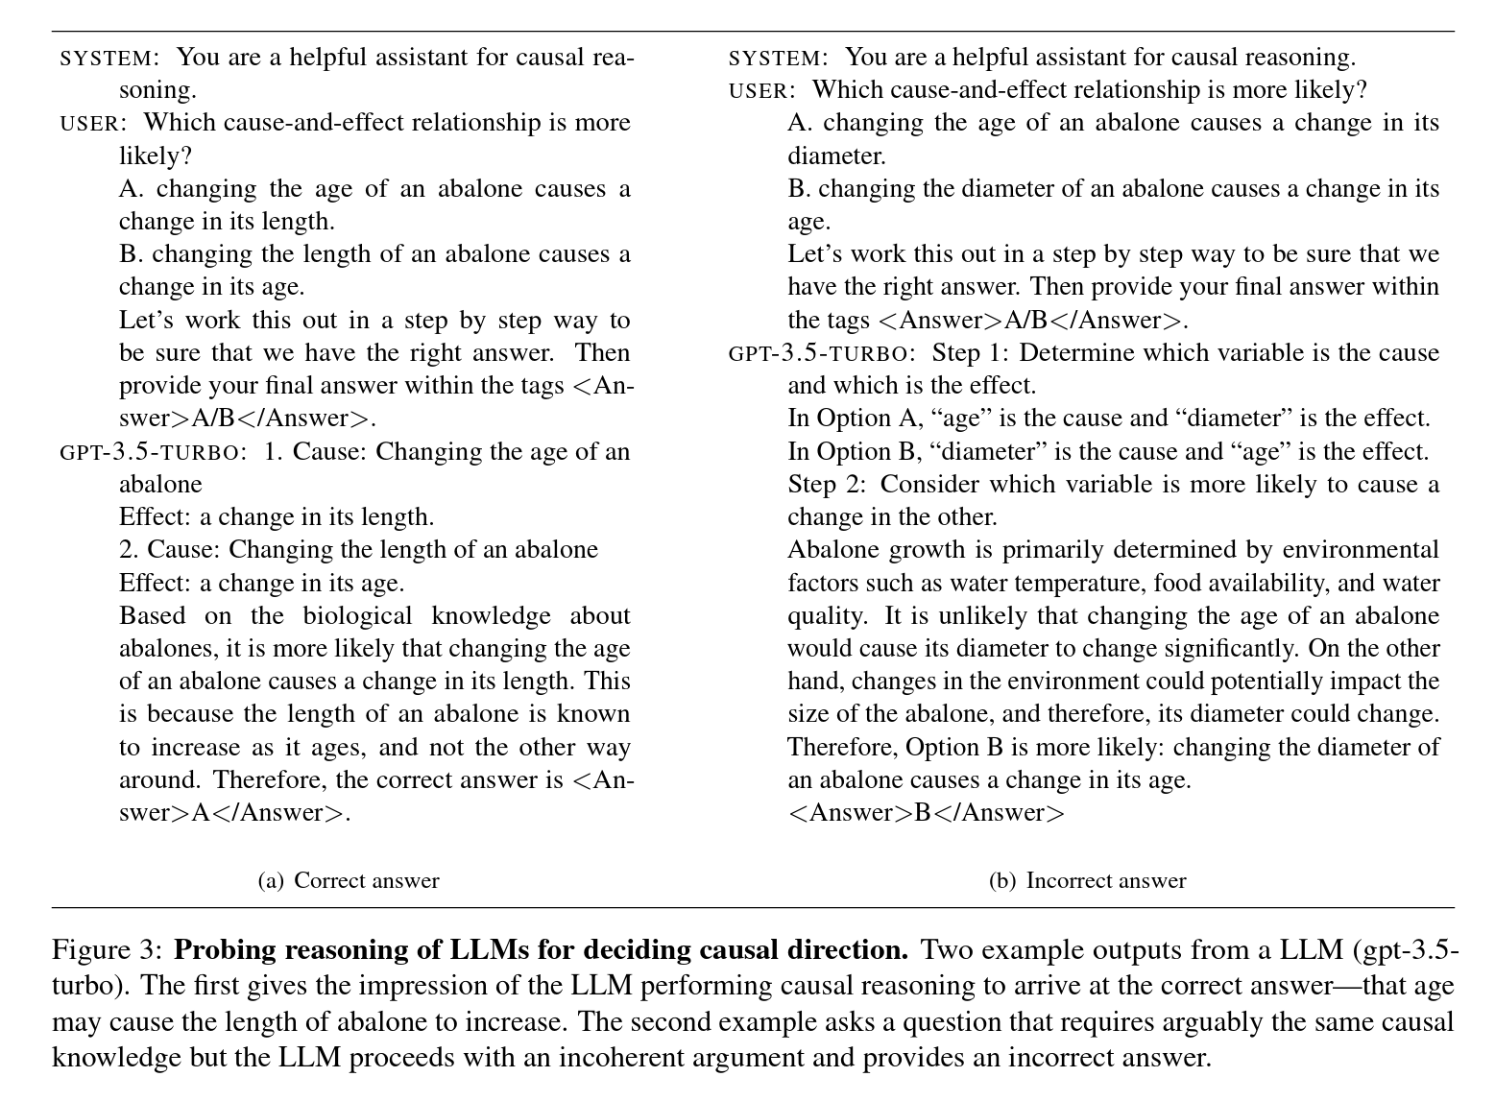

Slide 42
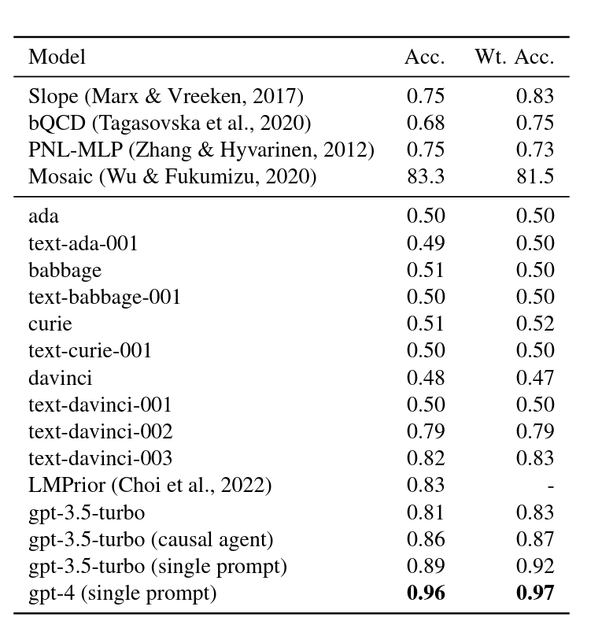
Results: GPT-4 obtains 96% accuracy, 13 points higher than previous SoTA
Evaluate all available models from OpenAI.
Two prompts template:
With increased model size (and perhaps RLHF), begin to see gains.
Smaller models (ada, babbage, curie) are similar to random chance.
With a single system prompt change, obtain 5 points gain!
System prompt: “You are a helpful assistant for causal reasoning”
Covariance-based
Knowledge-based
Single prompt template:
Obtain further gains in accuracy
GPT-4 obtains 97%
Surprising how few LLM errors are!
Notes:
Present results.
Then state they the methods are not directly comparable, but actually complementary using different sources: covariance and knowledge based

Slide 43
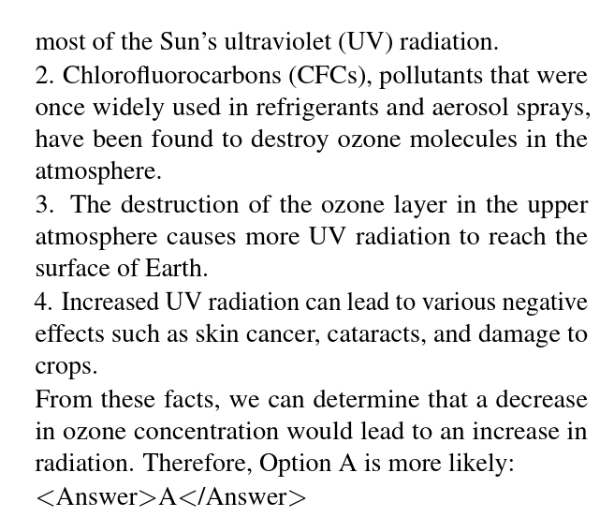

Still LLMs need specific instructions
Input Pair: Ozone concentration, Radiation

Slide 44
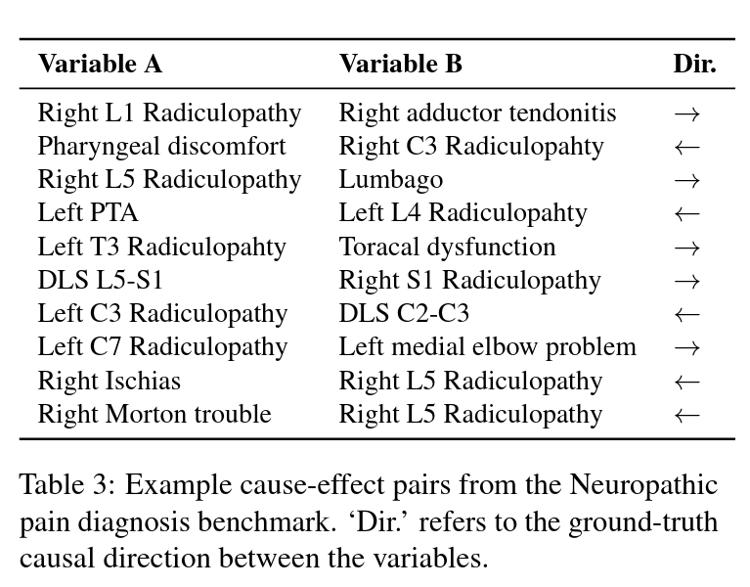
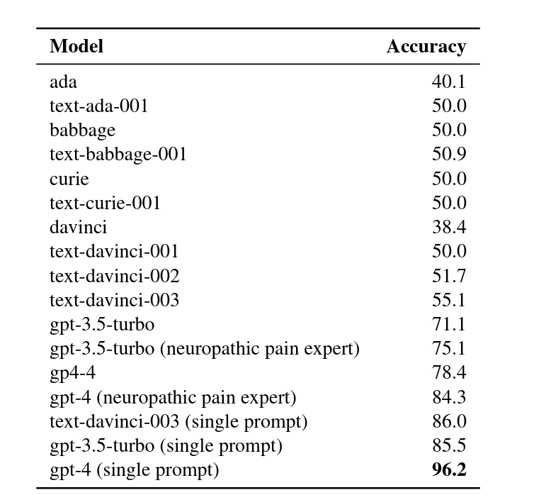
Similar results on a neuropathic pain dataset
221 nodes & 475 edges about neuropathic pain diagnosis [Tu et al. 2019]. Use all edges as pairs.

Slide 45
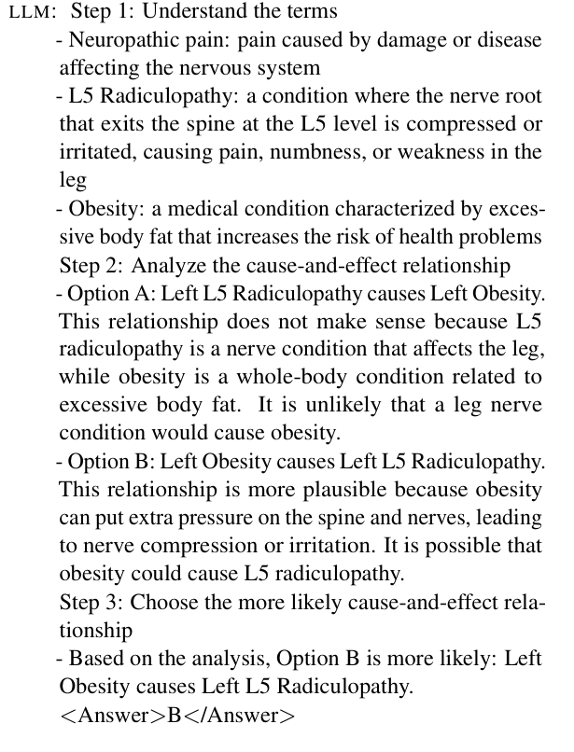
Example: “Incorrect”, but plausible LLM answer
Input Pair: L5 Radiculopathy, Obesity
Neuropathic Pain dataset: L5 Radiculopathy causes Obesity.
LLM (gpt-3.5-turbo): Obesity causes L5 Radiculopathy.
Medical Literature: Obesity may be a risk factor for radiculopathy [Atchison & Vincent, 2012; Tomic et al.,2009]

Slide 46
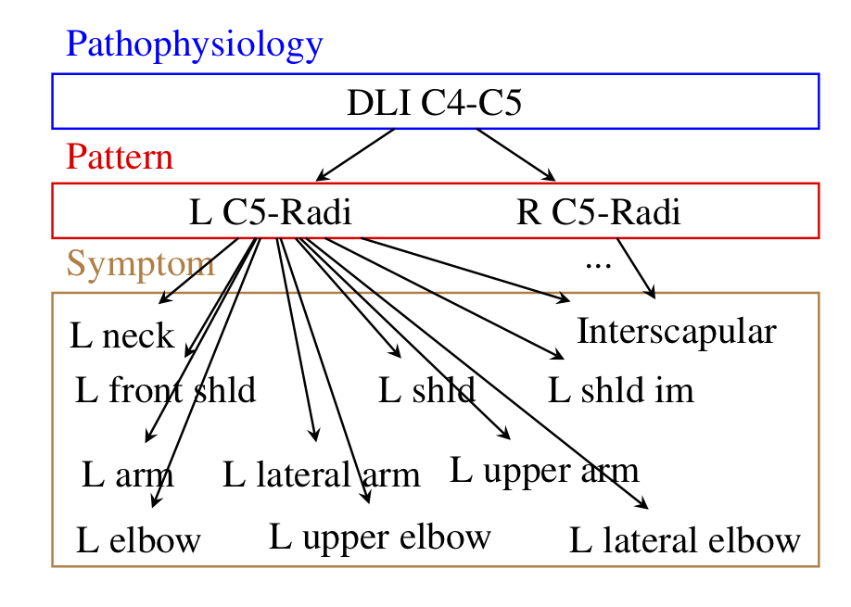
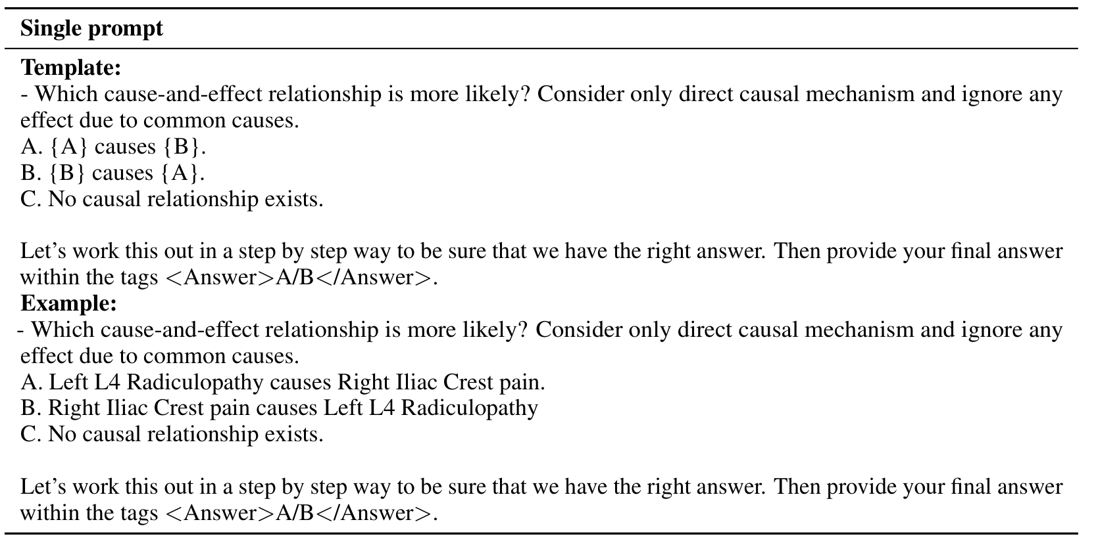
Full graph discovery: Neuropathic pain dataset
Use a 100 pair subsample [Tu et al. 2023]
50 correct edges, 50 non-existent edges
Need to infer existence + direction of an edge
Ground-truth graph

Slide 47
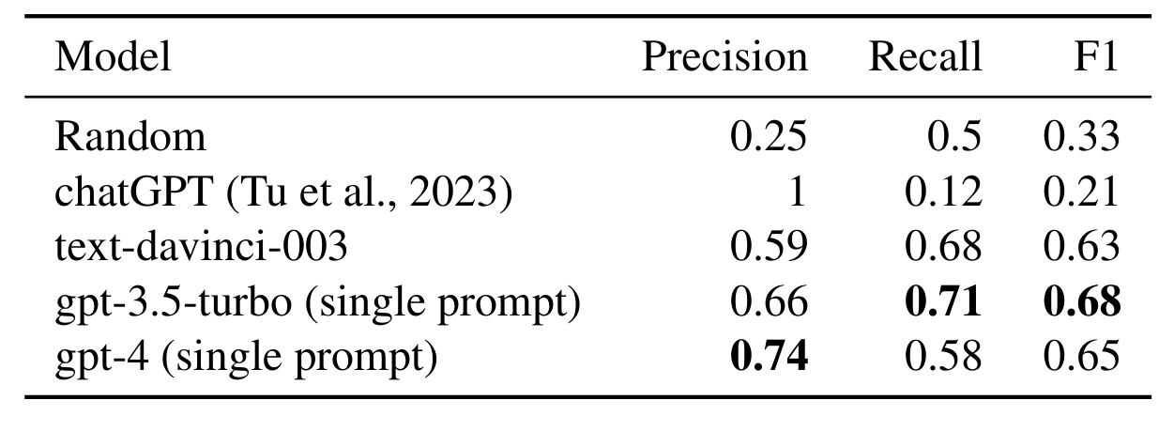
Prompt matters! With an improved prompt, we obtain 3x better accuracy in graph discovery
Simple use of ChatGPT resulted in 0.21 F1 on retrieving edges correctly.
With our single prompt, gpt-3.5-turbo (ChatGPT) obtains 0.68 F1.

Slide 48
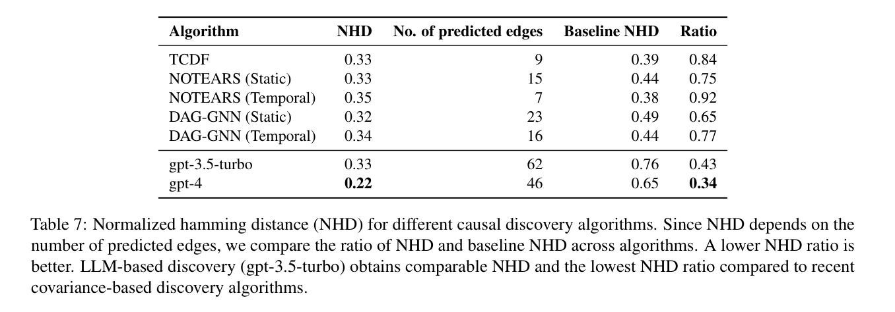
On an atmospheric science dataset, LLMs obtain higher accuracy than recent deep learning algorithms
Arctic sea ice dataset: 12 variable, 48 edges graph on the drivers of sea ice thickness in the Arctic region.
Variables: Total cloud water path, sea level pressure, geopotential height, meridional and zonal wind at 10m, net shortwave and longwave flux at surface, etc.

Slide 49



Construct Validity: Is Benchmark Memorized?
You are an AI assistant that has read many sources of text from the internet. I am looking at text from the dataset, published by as . Here is the README for the dataset: I am going to list some sample rows of data, and I want you to complete each row as best as possible. I am testing your memory.
SYSTEM
 | Cells | Rows
GPT-3.5 | 58.9% | 19.8%
GPT-4 | 61% | 25%
pair0005 Age
Yes, Tübingen dataset clearly in the training dataset.
USER
pair0005 Age Length Abalone ->
GPT

Slide 50
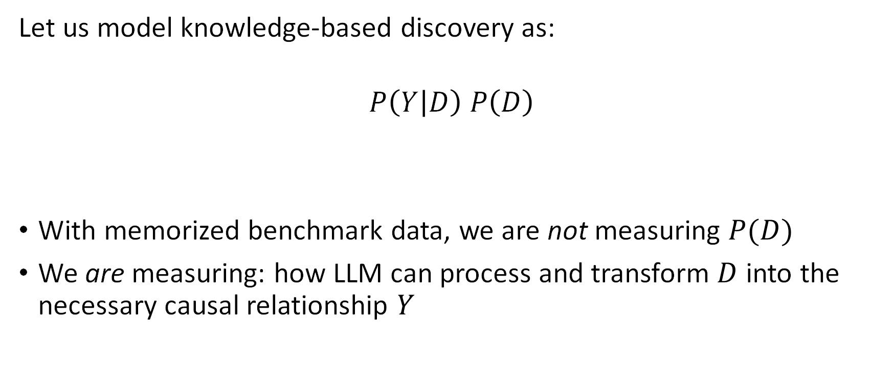
Construct Validity: What are we Measuring?
Let us model knowledge-based discovery as:
$$P\left(Y | D\right) P\left(D\right)$$
With memorized benchmark data, we are not measuring $P(D)$
We are measuring: how LLM can process and transform $D$ into the necessary causal relationship $Y$
Likelihood that knowledge can be transformed to answer question Y
Likelihood that knowledge D is known by LLM

Slide 51
Takeaways from the causal discovery section
LLMs enable knowledge-based causal discovery
Competitive performance in determining pairwise causal relationships
Across multiple datasets in varied domains incl. medicine and climate science
Full graph discovery poses additional challenges
E.g., distinguishing between direct and indirect causes
LLMs provide non-trivial utility for inferring full causal graphs
GPT-3.5, GPT-4 have memorized Tübingen benchmark
Our results are valid measurements of LLM ability to transform knowledge into a causal answer
Not valid for estimating the likelihood that arbitrary relationship has been memorized

Slide 52
Conclusion
Causal ML is important whenever we have decision-making or attribution tasks, or want generalizability of predictive model beyond the training distribution.
Causal graph is the most important assumption.
“No causes in, no causes out” – Judea Pearl
Open-source tools help make this assumption explicit and transparently share analysis with others.
But obtaining a causal graph is still the hardest problem.
Large language models can help the domain expert in building it.

Slide 53
Causal ML extras: What we did not cover
Causal identification using instrumental variables
Propensity-based estimation methods for effect estimation
Refutation and sensitivity analyses for causal ML
Connections to reinforcement learning
Refer to book draft, Causal Reasoning: Fundamentals and Machine Learning Applications (causalinference.gitlab.io/book)

Slide 54
Thank you!
Amit Sharma

